Slide 1

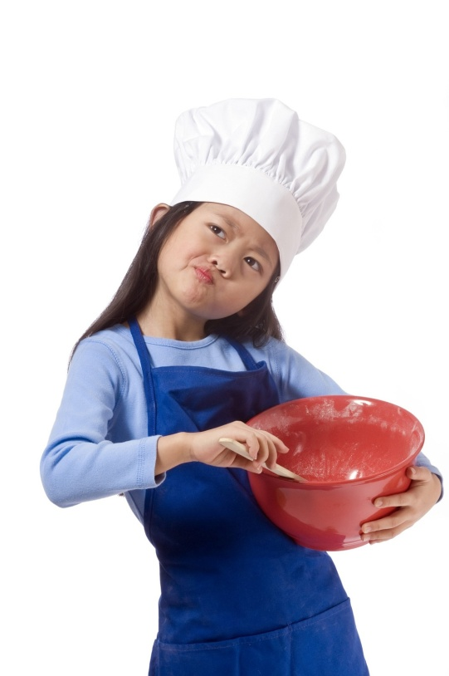
Food and Kitchen Safety
Journal Focus
What could happen if I don’t
pay attention to
kitchen safety?

Slide 2
Vocabulary Words:
These will be underlined on the slides.
Contaminants
Food borne illness
Salmonella
Food Safety
Personal Hygiene
20-second scrub
Cross-Contaminate
Sanitation

Slide 3
Food Safety
How often do you wonder whether the food is safe to eat?
Most people take food safety for granted.
Contaminants:
  Harmful BAC that gets into our food and makes it unsafe for us to eat

Slide 4
But, there are things you can do to prevent contaminants!
This is what we will talk about today

Slide 5
Food Borne Illness
(AKA Food Poisoning)
Sickness caused by food that contains harmful bacteria
Symptoms:
  Fever, headache, digestive troubles
  “Upset Stomach”
Strikes 75 million Americans every year
Children, pregnant women, older adults, and chronically ill
Bacteria are single celled organisms. Most bacteria are not bad for us, but some can make us very sick

Slide 6

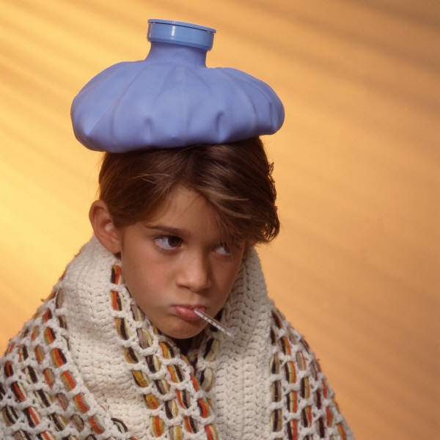
Food Borne Illness
Most cases, mild (1-2 days)
Some people require hospitalization (~300,000 people)
5,000 deaths/year

Slide 7
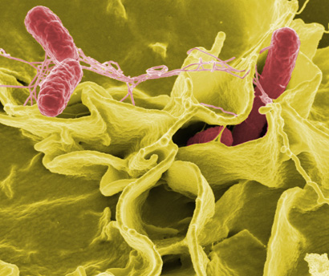
Salmonella
This is a harmful bacteria that can make you very sick!

Slide 8
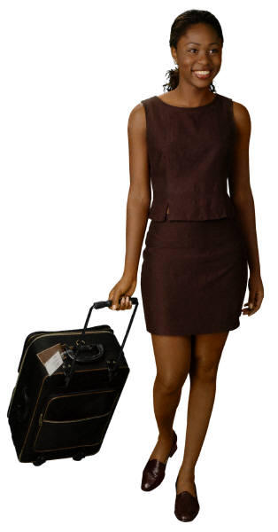
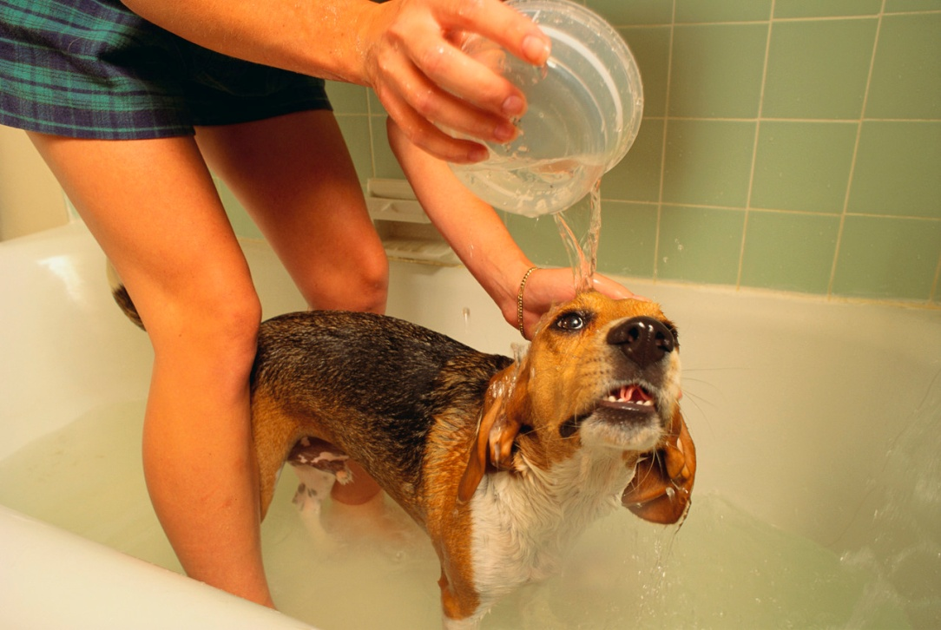
How do these bacteria travel ?
Well, they can’t travel far by themselves
People, animals, insects, and objects

Slide 9


How do bacteria get in my food?
Harmful bacteria can occur naturally in food when you buy it
Most arrive through careless handling when food is prepared and served.

Slide 10
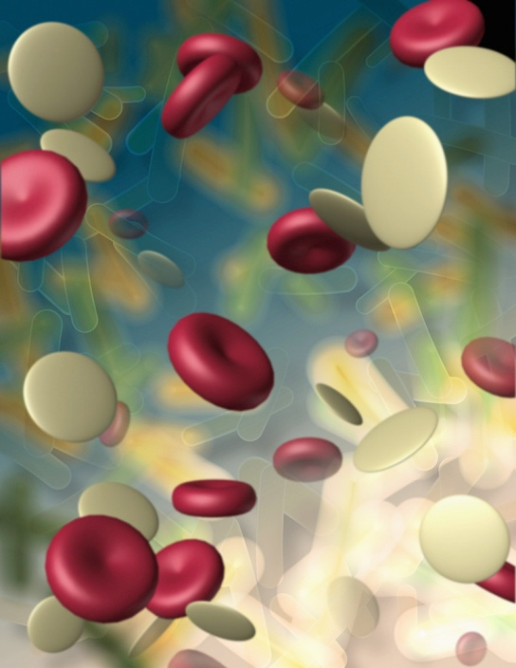
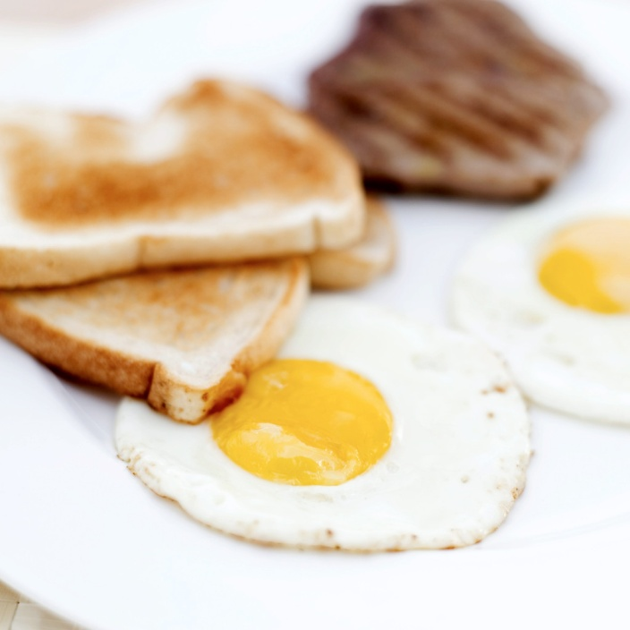
Food Borne Illness….
Bacteria reproduce at a very fast rate. In just a few hours, one can multiply to thousands.
Food may look, taste, and smell completely safe to eat.

Slide 11
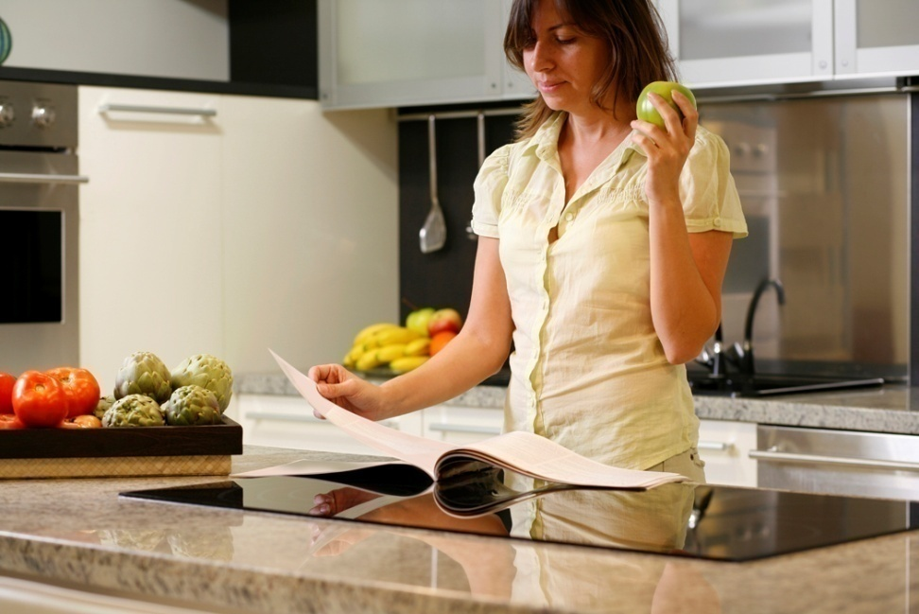
Food Safety:
Keeping food safe to eat by following proper food handling and cooking practices
1. Clean
2. Separate
3. Chill
4. Cook

Slide 12
The 4 Food Safety Practices
Clean. Why?
Bacteria can spread throughout the kitchen and get on hands, utensils and countertops.
Separate. Why?
Cross-contamination is how bacteria spreads. Keep raw meat, poultry, seafood and eggs away from ready-to-eat foods.

Slide 13
The 4 food safety practices
Cook. Why?
  Improper heating & preparation of food means bacteria can survive.
Chill. Why?
  Bacteria grows fastest between 40 °F and 140 °F. Proper chilling is important to reducing risk of illness.

Slide 14
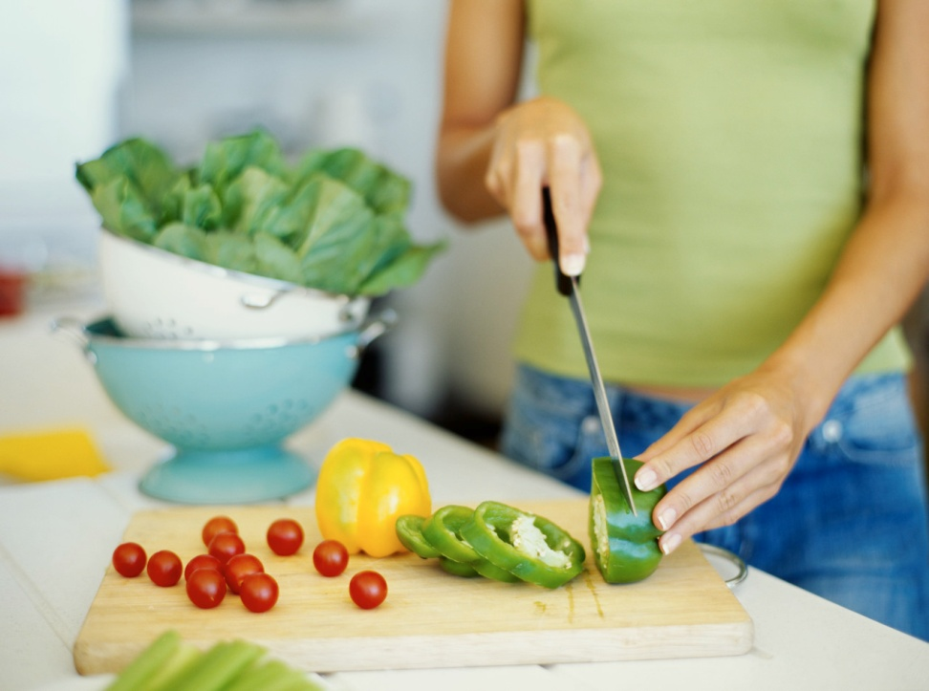
Tips When Cooking:
Roll up sleeves
Tie back long hair
Remove dangling jewelry
Wear gloves if you have a cut or wound
Clean up spills, tools, and work surfaces as you go

Slide 15
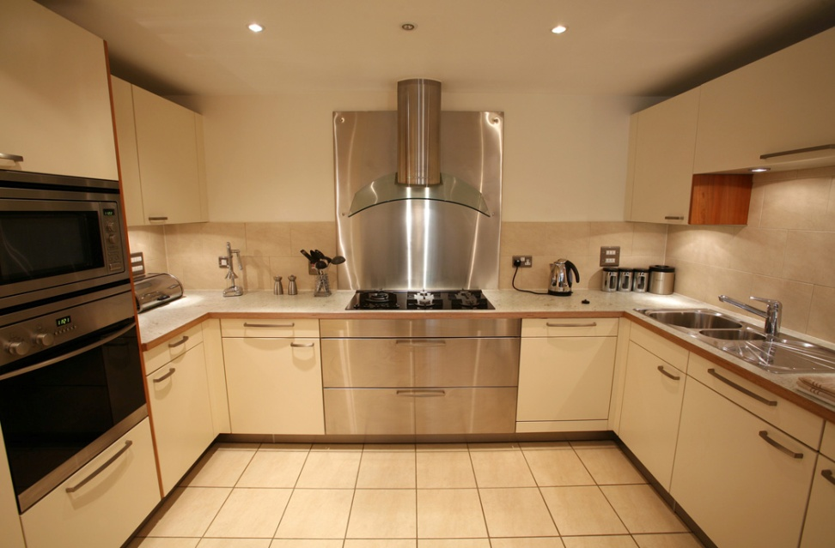
Cleanliness in the Kitchen
Where we start for proper sanitation
  Prevention of illness through cleanliness and food safety

Slide 16
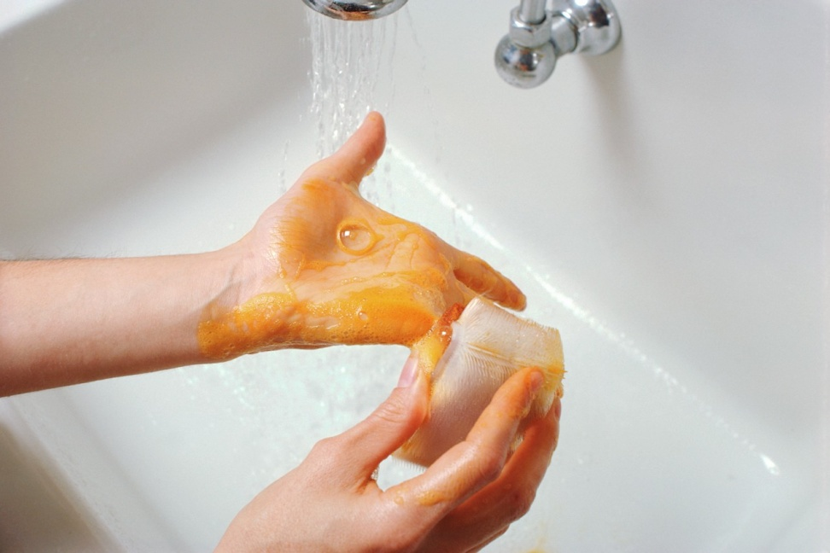
Personal Hygiene
Keeping yourself clean to avoid transferring harmful bacteria when handling food
Don’t want bacteria to transfer from your body to your food!

Slide 17
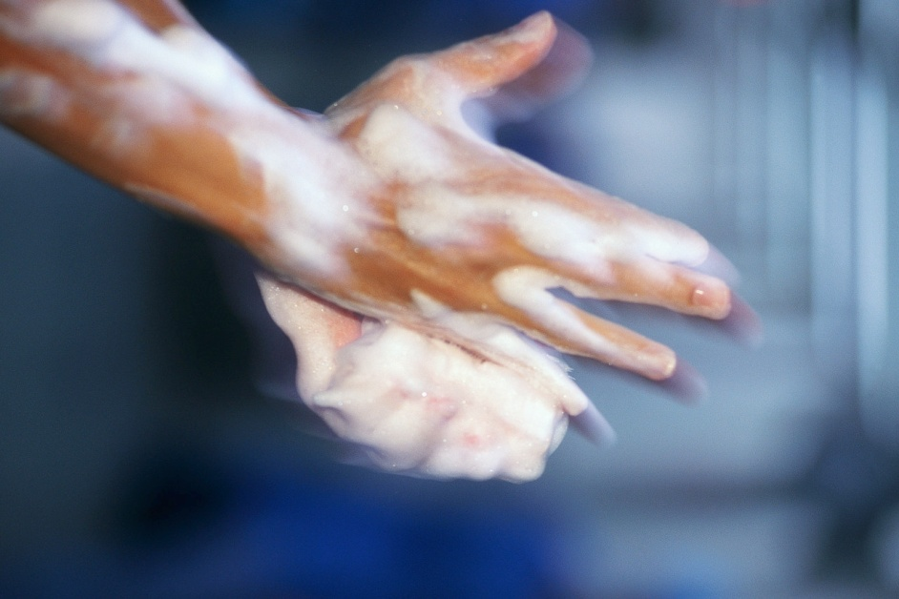
20-Second Scrub
Using soap and warm water, scrub your hands for 20 seconds
Keeping your hands clean is the single most effective way to prevent bacterial transfer.
After handling raw meat or coughing/sneezing-scrub!!!
Always do the 20-second scrub before cooking or eating!

Slide 18
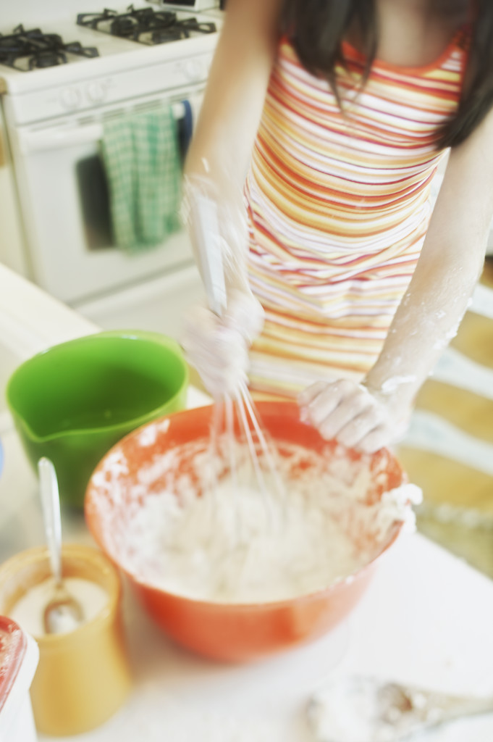
A Kitchen With Proper Sanitation
No pets
Keep everything clean
Wash tops of cans
Change dishtowels often (OR use paper towels!)
Clean up after because dirty dishes can harbor harmful bacteria

Slide 19
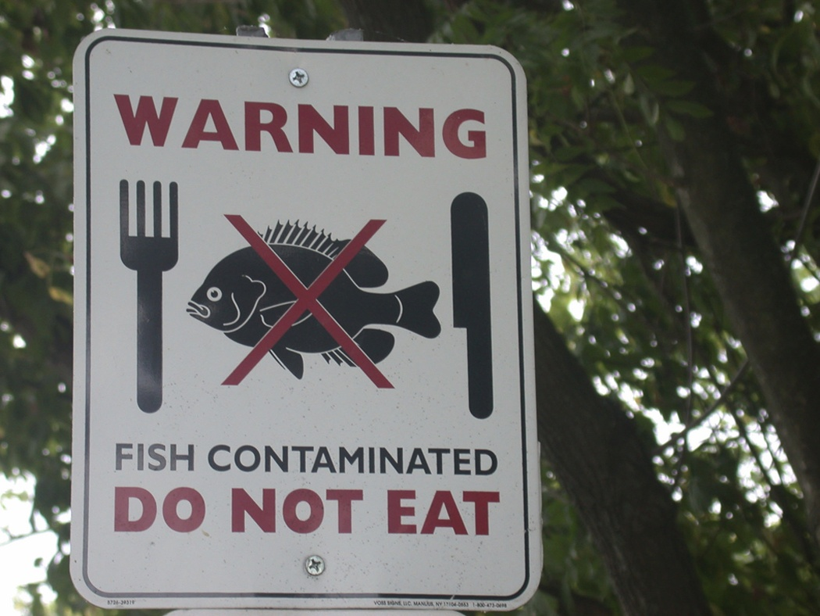
Cross Contaminate
When harmful BAC spread from one food to another
Occurs with cooked and uncooked foods
What are some examples?
Never put cooked food on a plate raw food was on!

Slide 20
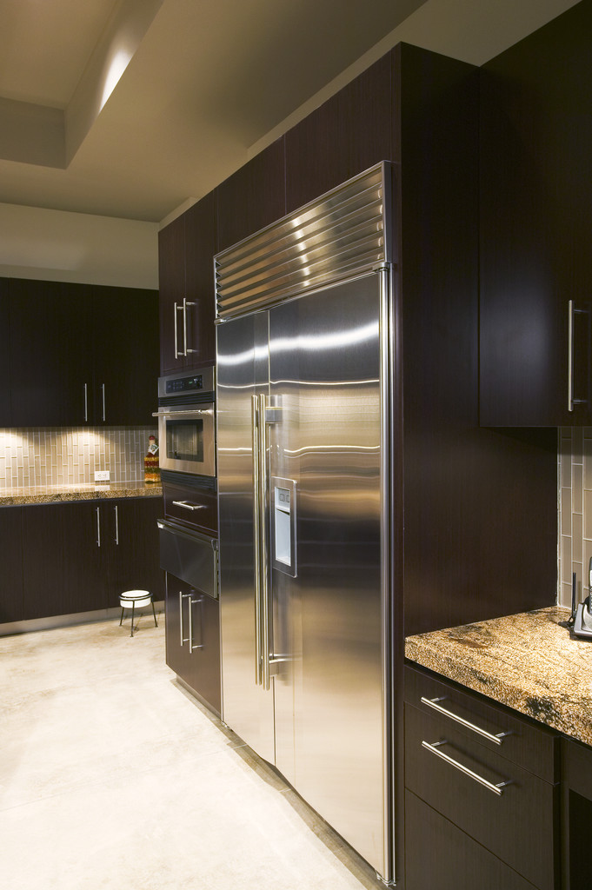
It’s also important to cook food thoroughly and to refrigerate it promptly.

Slide 21
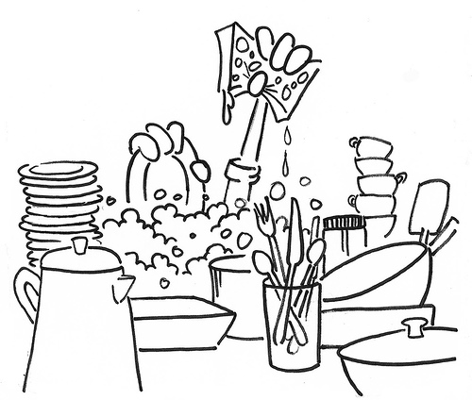
This is how we wash dishes:
1.) Rinse excess food off
2.) Wash in hot, soapy water
3.) Rinse dish until clean
4.) Drip in drainer
5.) Dry

Slide 22
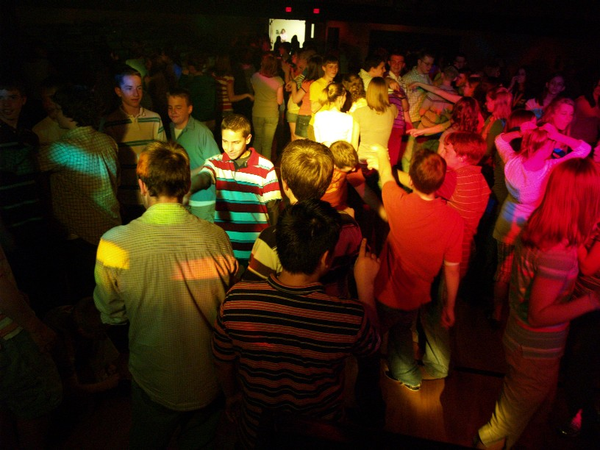
Let’s read about the
“School Dance Disaster.”
You will need your journal!
Image taken from: www.inrealitydigitaldj.com

Slide 23
School Dance Disaster
Justin, a 12 yr. old, volunteered to prepare the food for the big school dance. He had just moved to this area, but never had a foods class before. All the guys in his neighborhood were busy cooking because they learned so much from their foods teacher in school. Justin was a little late in getting up, so he didn’t start cooking until noon. He had to be finished and ready at 5 p.m.
The first item to prepare on Justin’s list was egg salad sandwiches. As Justin put the eggs in the water to boil, he filled the pot a little too full and it spilled by the time all the eggs were put in. He grabbed the towel he used for drying dishes and immediately wiped up the spill on the floor. While the eggs were cooling, Justin began the chicken salad. The chicken had thawed on the counter since last night, so it was ready to be boiled. He thought it smelled odd, but decided to use it anyway since he didn’t have time to wait for more chicken to thaw. The boiling water would certainly kill any germs he thought.

Slide 24
Justin was dressed in a long baggy shirt. As he tried to fix his sleeves one more time, his long-hair cat, Cuddles, jumped onto the counter. She loved attention and the family always let her sit wherever she wanted to. So, back to cooking, Justin added the mayonnaise and other spices to the cut up chicken. Finally Justin finished and packed it into a box sitting on the table. The sandwiches were already in the box.
The last item to be made was the fruit salad. Justin just grabbed some cans of peaches, fruit cocktail and pineapple chunks. One can was dented, but Justin thought nothing of it. It wasn’t leaking, so it must be ok to use. He added the other fresh fruit and stirred it with a wooden spoon. It looked so good he just had to taste it, and he licked the wooden spoon. He decided a little more cinnamon would be good, so he sprinkled some in and stirred it again with that same wooden spoon. Now all the food was ready and it was time to change clothes and then wake his mother to take him to the dance.
At the dance Justin noticed all the food he prepared disappeared quickly. Everyone had a great time, but as people started leaving, they were getting stomach cramps and flu-like symptoms….

Slide 25
You will name your assignment: “School Dance Disaster”. You will answer these questions in your journal.
1. What 3 foods could have caused food poisoning?
2. In what foods will you find Salmonella?
3. List at least 5 mistakes Justin made while handling the food.
4. What should you do to raw fruits and vegetables before you use them?
5. How do you prevent food poisoning when using chicken and eggs?
6. How do you practice sanitation in the kitchen?

