Slide 1
Energy Career Fair Preview
MAA Middle School

Slide 2
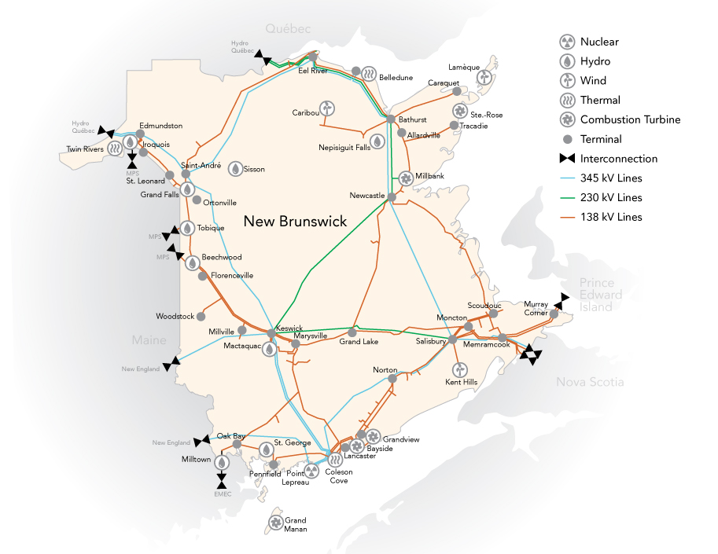
NB Power
There will be two representatives from NB Power
One rep will represent Efficiency (click on link to see definition)
The second rep will represent engineering

Slide 3
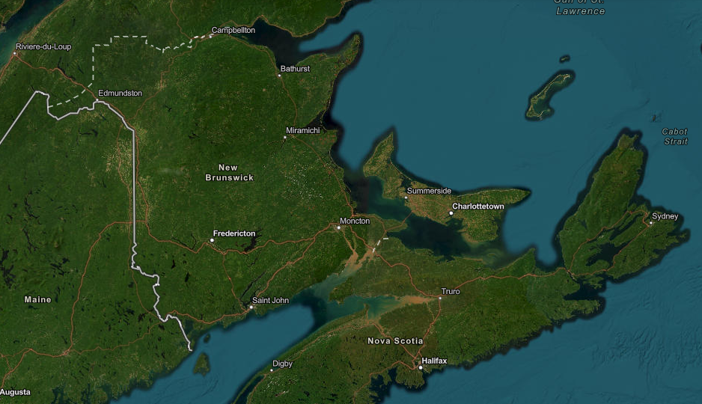
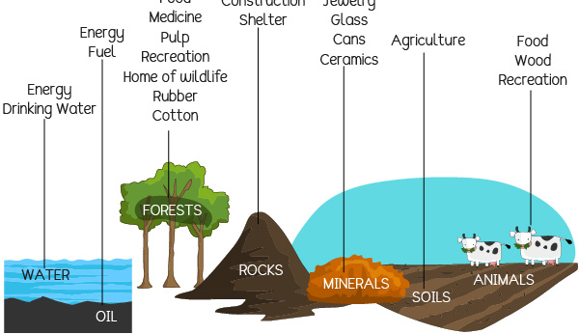
Department of Natural Resources and Development
Natural Resources and Energy Development
Job Statistics due to small modular reactor: page 5
https://youtu.be/URmOQMfG3DI (What is a small modular reactor? – video)
What are natural resources? See picture to the left.

Slide 4
Erin Polka

Slide 5
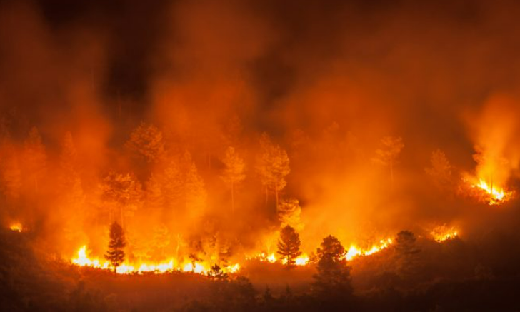
Miramichi Fire Department – Forests As a Natural Resource

Slide 6
WOMEN IN RENEWABLE ENERGY
https://womeninrenewableenergy.ca/

Slide 7
Drone Operator
Jody Coakley is a drone operator/pilot who will be attending our career fair.
Link to drone operator jobs: https://ca.indeed.com/Drone-Operator-jobs?vjk=0e221bf3c5266f00

Slide 8
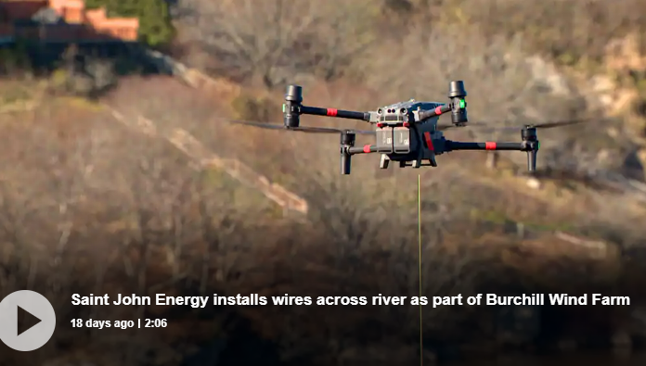
Saint John Energy Fun Fact

