Slide 1
PERISCOPE PROJECT
Have students construct a periscope out of simple materials.
Have students develop ways of testing accuracy, distance, etc.
Students develop ‘testable questions’ related to periscope, then must conduct a mini-investigation. Brainstorm variables you could ‘manipulate’ and variables you could ‘observe’!
Use project to introduce angle of reflection, properties of light.

Slide 2
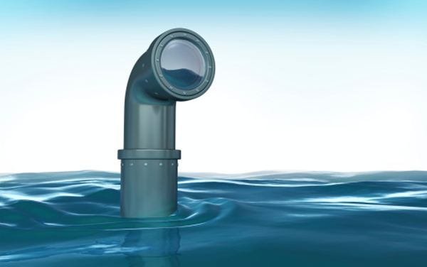
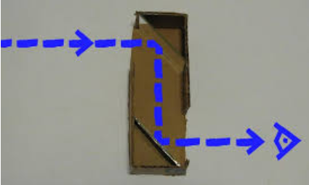
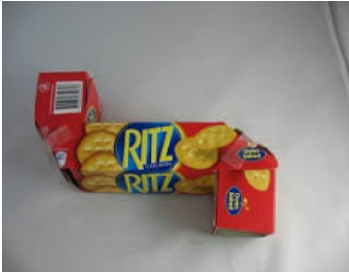
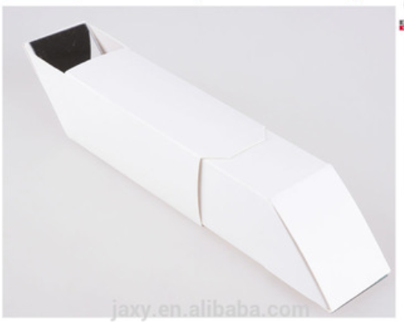
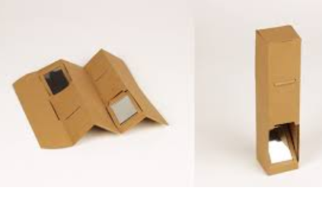
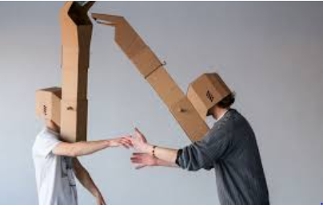
What is a PERISCOPE?

Slide 3
1) Sketch your design:
Name:
HR:
Date:
Periscope
2) What were changes you had to make for your design? (Draw them if needed)
3) How did everyone work in your group?
4) How could you improve your design if you were to make this again?
Teacher Comments:

