Slide 1
What Makes a poem, A poem?
Grade 6/7 Language Arts

Slide 2
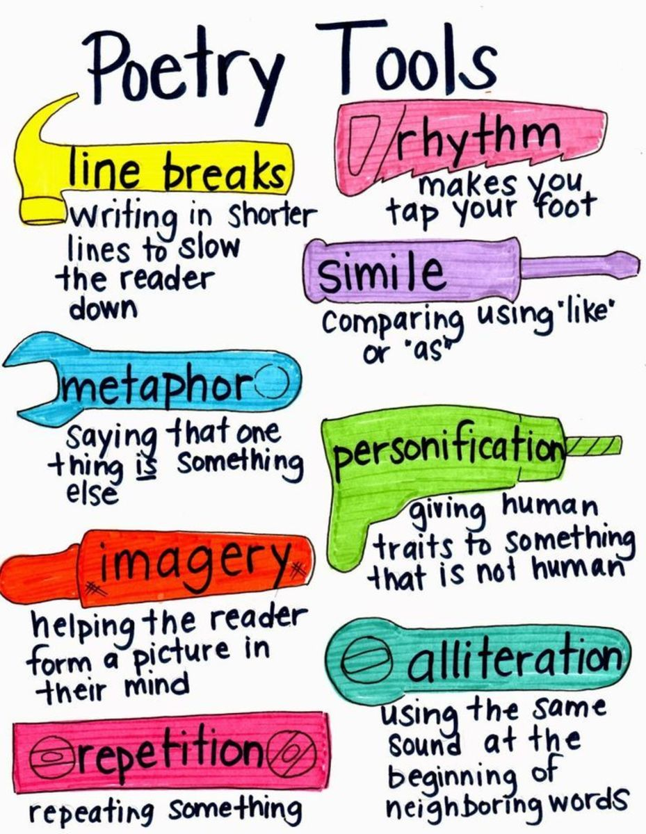
What makes a poem, a poem?
By Melissa Kovacs
-watch video by clicking on the title above

Slide 3
Recognizable characteristics of poems:
Poems emphasize language’s musical qualities (rhyme, rhythm and meter)
Poems used condensed literature
Feature intense feelings

Slide 4
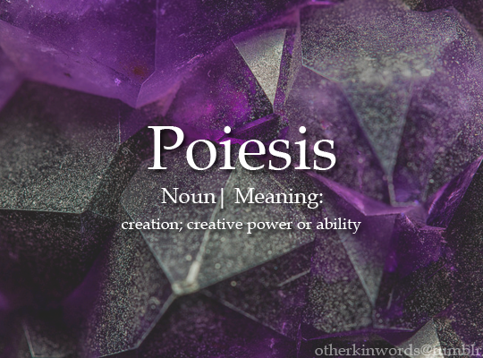
Where does the word “poetry” come from?
It comes from the Greek word “poesis,” which means “to create” or “a making.”

Slide 5
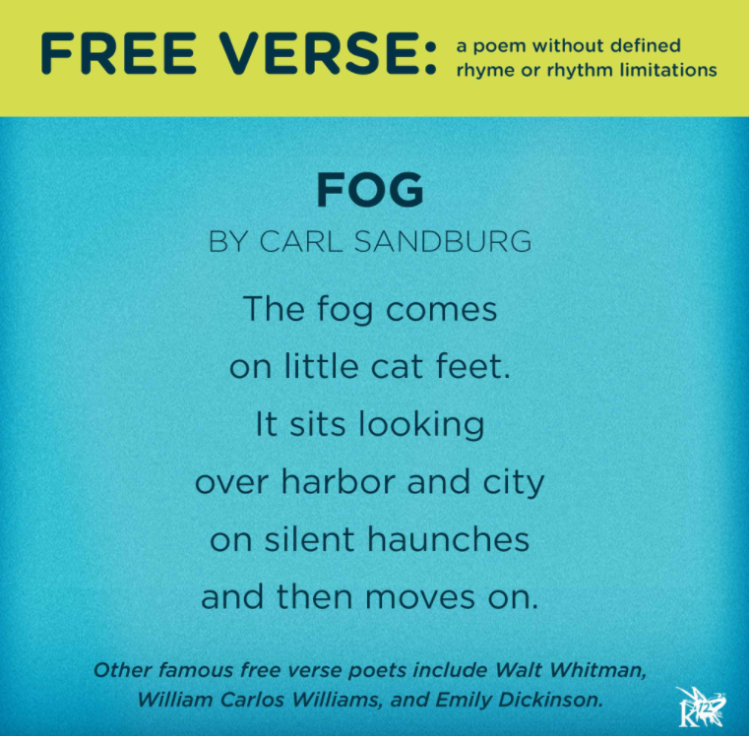
Free Verse Poetry
In Grade 7 we learn about a “free verse poem.” Write the definition of the word and find one that you like. Here is an example.

Slide 6
What is “slam poetry?”
slam poetry - a form of performance poetry that combines the elements of performance, writing, competition, and audience participation.
Watch: If You Give a Child a Word— spoken art | Brandon Sanders and Mikeala Miller | TEDxYouth@FtWorth

