Slide 1
Memoirs
Grade 6/7 Language Arts

Slide 2
Everyday Leadership

Slide 3
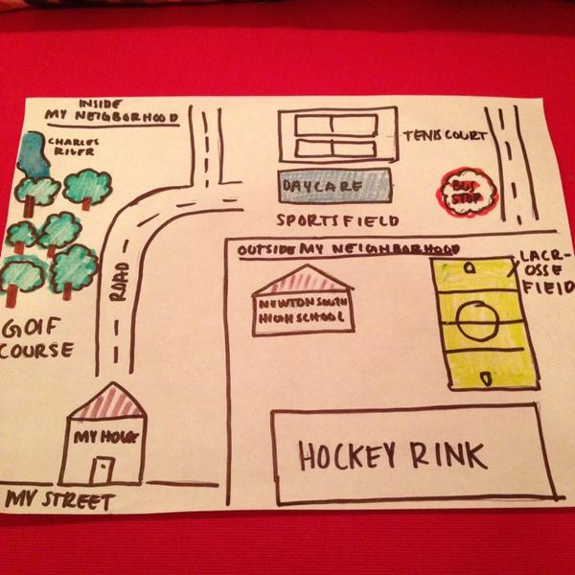
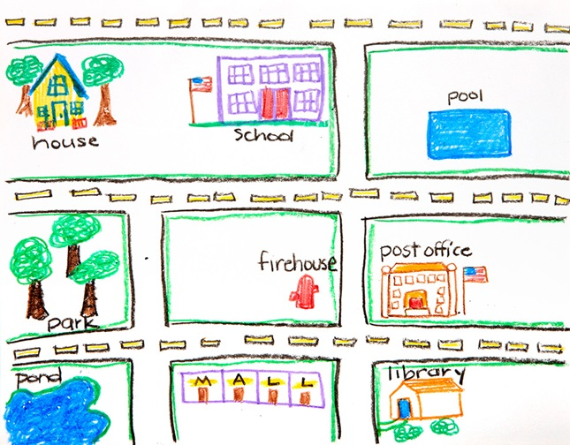

Slide 4
Video Discussion
The video is not only a great video about kindness and leadership, but also a great memoir. The speaker describes a memory in detail, then ends by sharing the learning that goes with the memory.
Please draw a neighbourhood map. This map will help you remember some memories that you may have, that might be great for a memoir. This must be done by the end of class tomorrow, Wednesday.

Slide 5
Neighborhood Map
 | Complete | Mostly | Some | None
Student’s name and the date are on the map. | 4 | 3 | 2 | 1
Student’s map is colorful and creative. | 4 | 3 | 2 | 1
Student’s map has a title. | 4 | 3 | 2 | 1
Student included street name(s). | 4 | 3 | 2 | 1
Student drew a compass rose. | 4 | 3 | 2 | 1
Student’s map is neat and organized. | 4 | 3 | 2 | 1
Student used correct capitalization, spelling, and grammar. | 4 | 3 | 2 | 1
Neighborhood Map Rubric
Name: ______________
Date: _______________

Slide 6
Sample Memoir
THE UNDEXPECTED DANGERS OF ROASTING MARSHMMALLOW
https://www.readwritethink.org/sites/default/files/resources/lesson_images/lesson31031/Sample_Memoir_forRevision.pdf

Slide 7
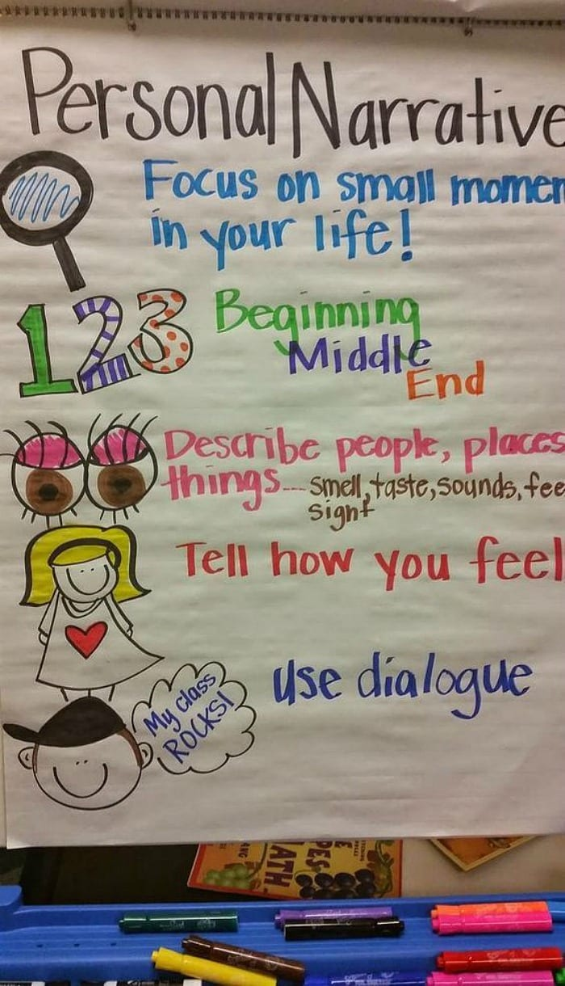

Slide 8
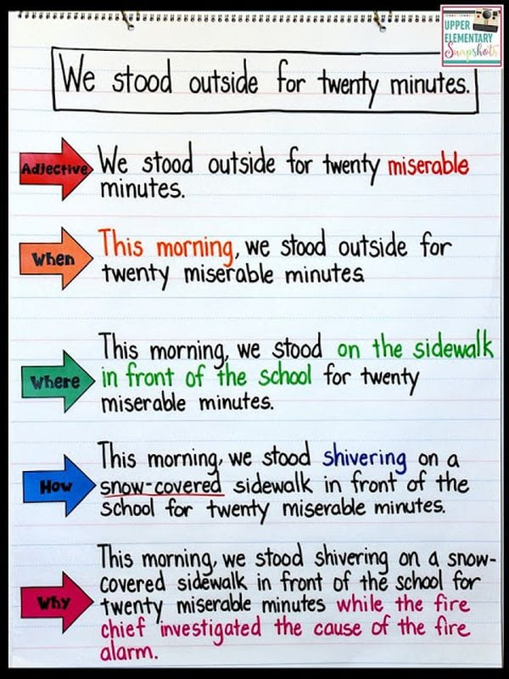

Slide 9
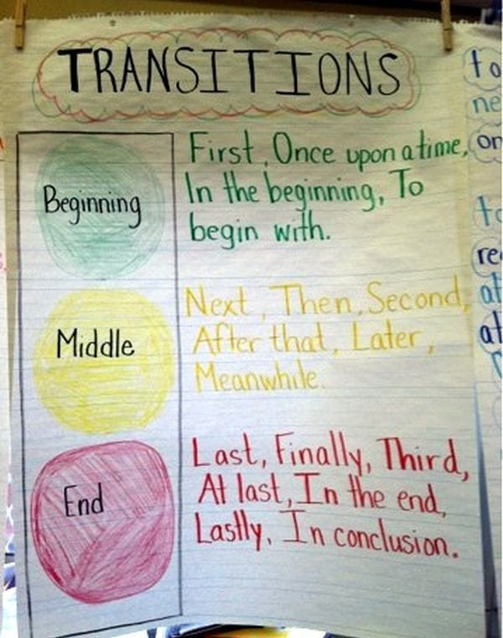

Slide 10
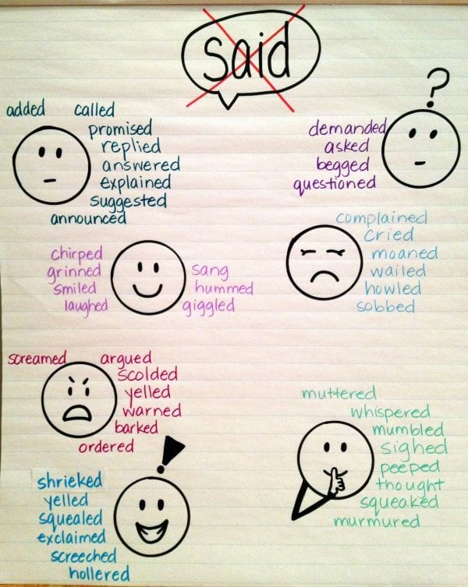

Slide 11
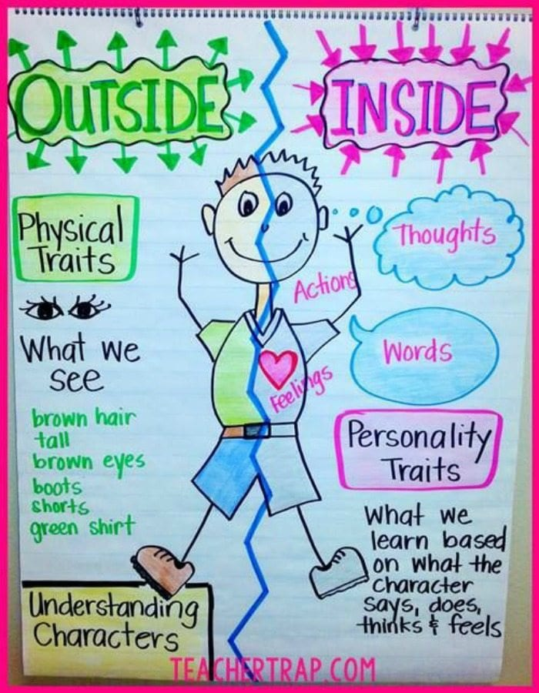

Slide 12
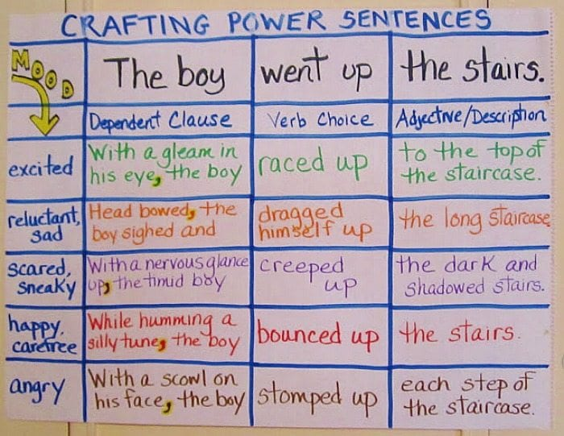

Slide 13
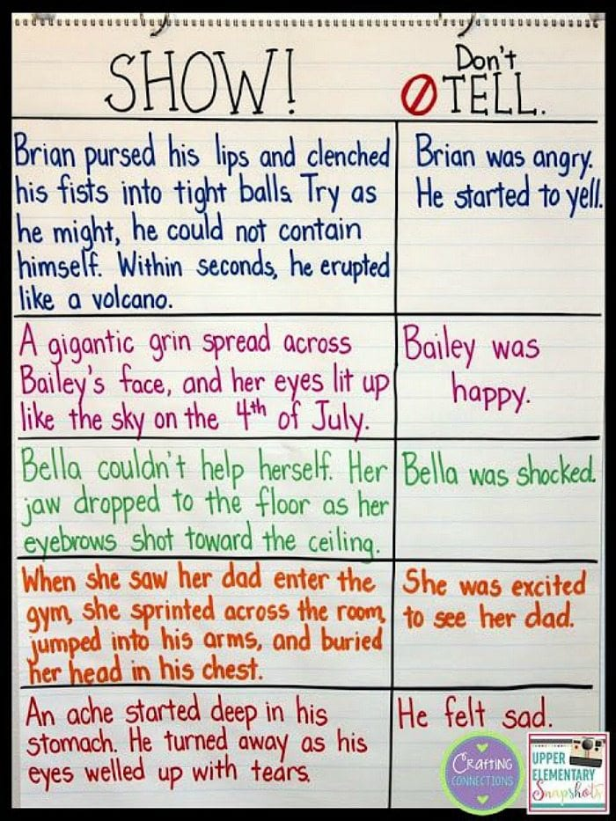

Slide 14
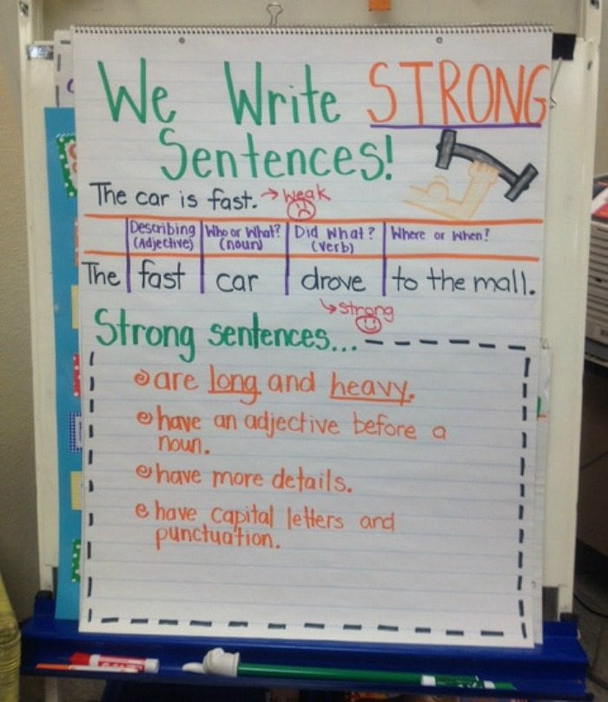

Slide 15
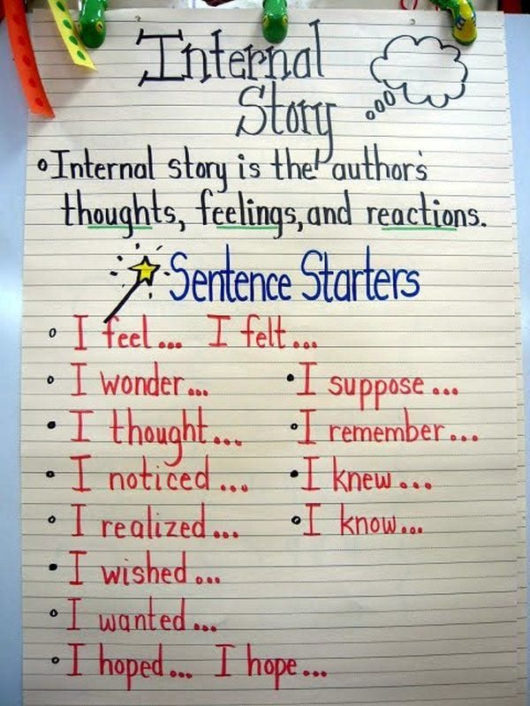

Slide 16
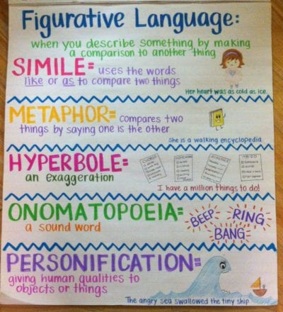

Slide 17
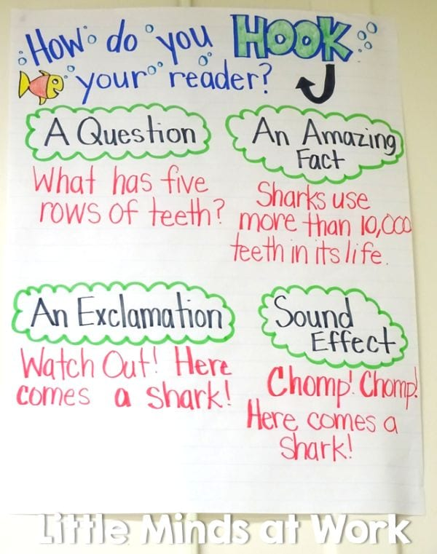

Slide 18
References
https://www.weareteachers.com/25-awesome-anchor-charts-for-teaching-writing/
https://www.teachwriting.org/612th/2022/8/15/5-personal-narrative-writing-scaffolds

