Slide 1
Home Learning
Mrs. McLean

Slide 2
Similes

Slide 3
Simile
She is as swift as a fox.
My dog walks like cold molasses.

Slide 4
Examples of Metaphors

Slide 5
Metaphors
The cloud is a dragon.
He is a cheetah.
The car is a speeding bullet.

Slide 6
Examples of Personification

Slide 7
Examples of Personification
The car coughed and died.

Slide 8
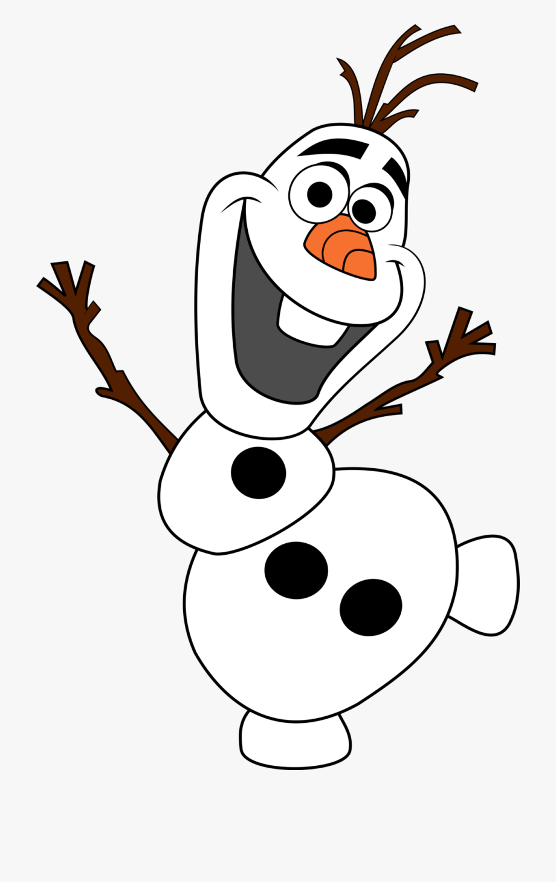
Warm-Up Songs for Winter
Olaf “In Summer”

Slide 9
There, They’re, Their
We love going to their house because their mother always gives us good snacks.
They’re (they are) really excited for the winter carnival.
Please put your bags over there and sit here beside me.

Slide 10
SMARt Goals or New Years’ Resolution

Slide 11
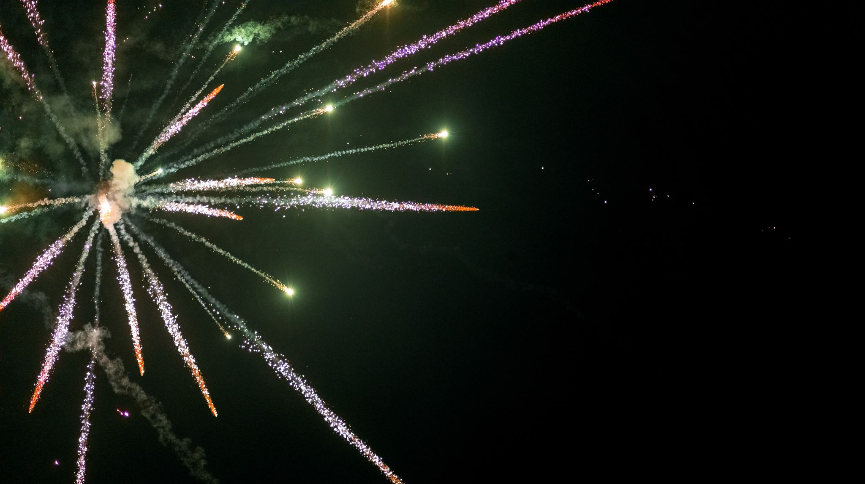
Examples of New Years Resolutions

Slide 12
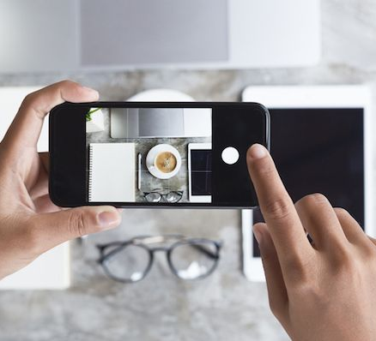
Photography Tips
Photography 101: How to Take Good Pictures With Your Mobile Device

Slide 13
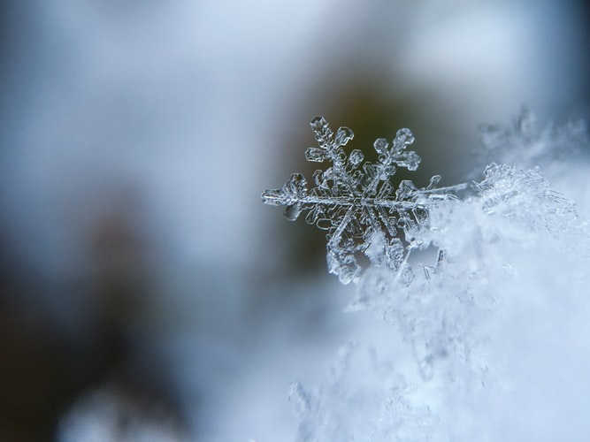

Slide 14
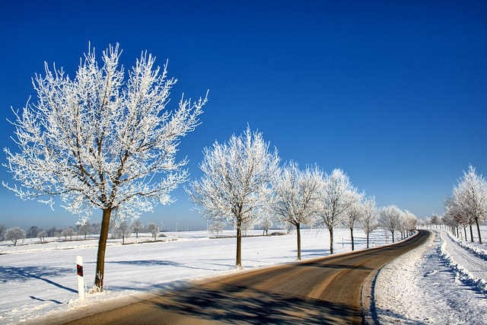

Slide 15
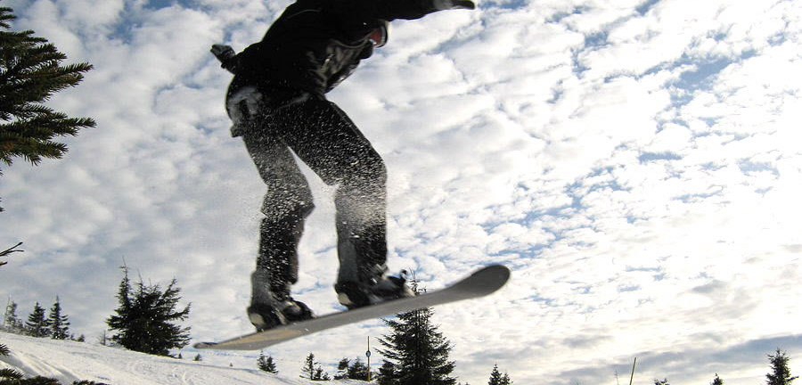

Slide 16
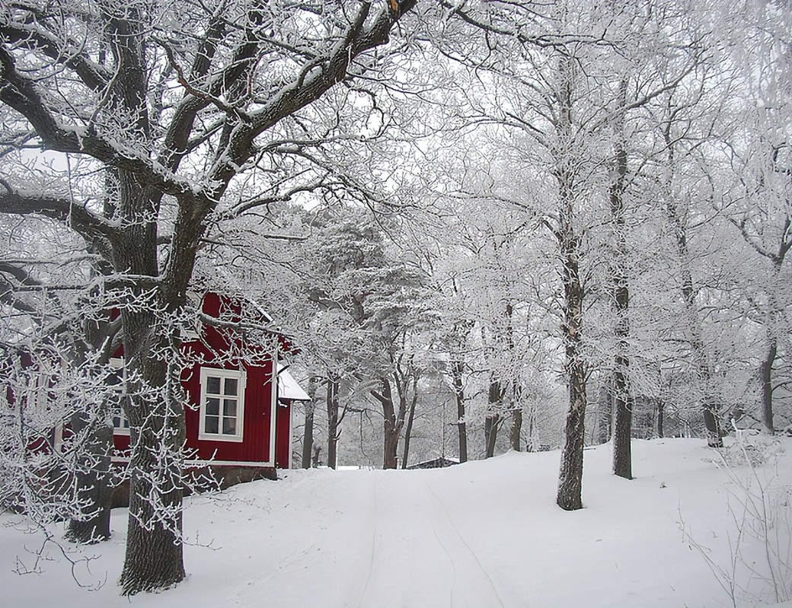

Slide 17
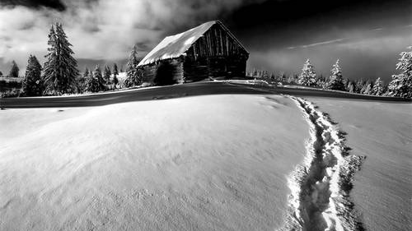

Slide 18
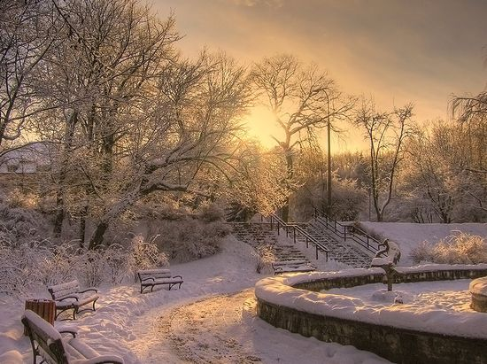

Slide 19
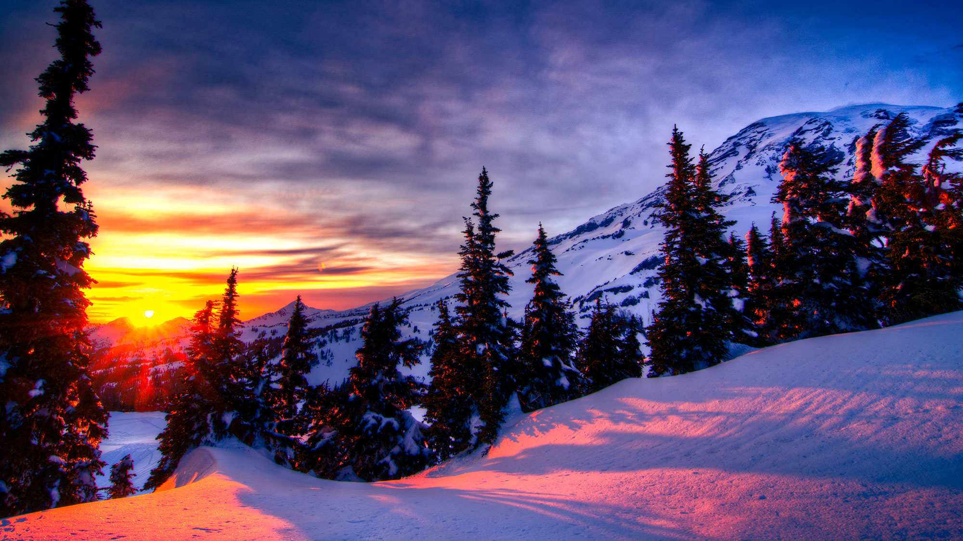

Slide 20
Homophones
piece, peace
whole, hole
no, know
homophones - Match up (wordwall.net)

Slide 21
3 Kinds of Connections to Texts
TEXT TO SELF
TEXT TO TEXT
TEXT TO WORLD

Slide 22
Model Textual Connections
P. 100 Harry Potter and the Philosopher’s Stone
Amazon.ca : harry potter and the philosopher's stone
..\..\Literacy Grade 6 & 7\Reader's Notebook\Soto_Making_Connections.ppt

Slide 23
What Keeps You Reading
When someone recommends a book
The history of the book
Word choices
Facts
Problems in the book
I trust the author
The way the words are written
I like the front cover
I read the back of the book
I want to know what happens

Slide 24
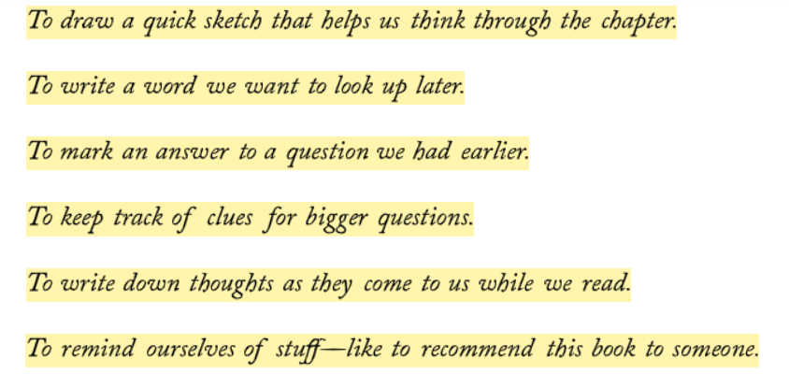
Sticky Note strategy

