Slide 1
Diving into the decades
2010- present day!

Slide 2
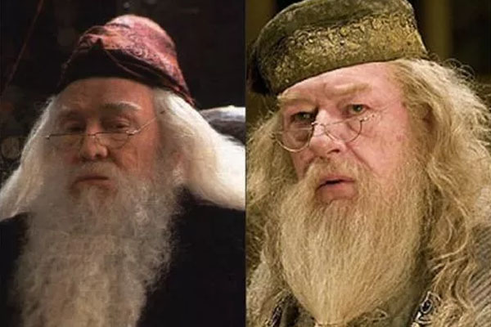
Who Am I?

Slide 3
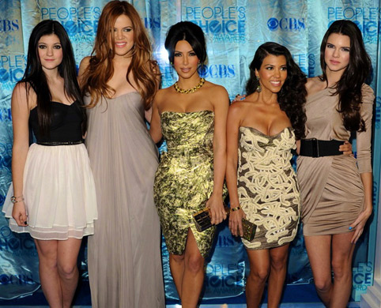
Who are we?

Slide 4
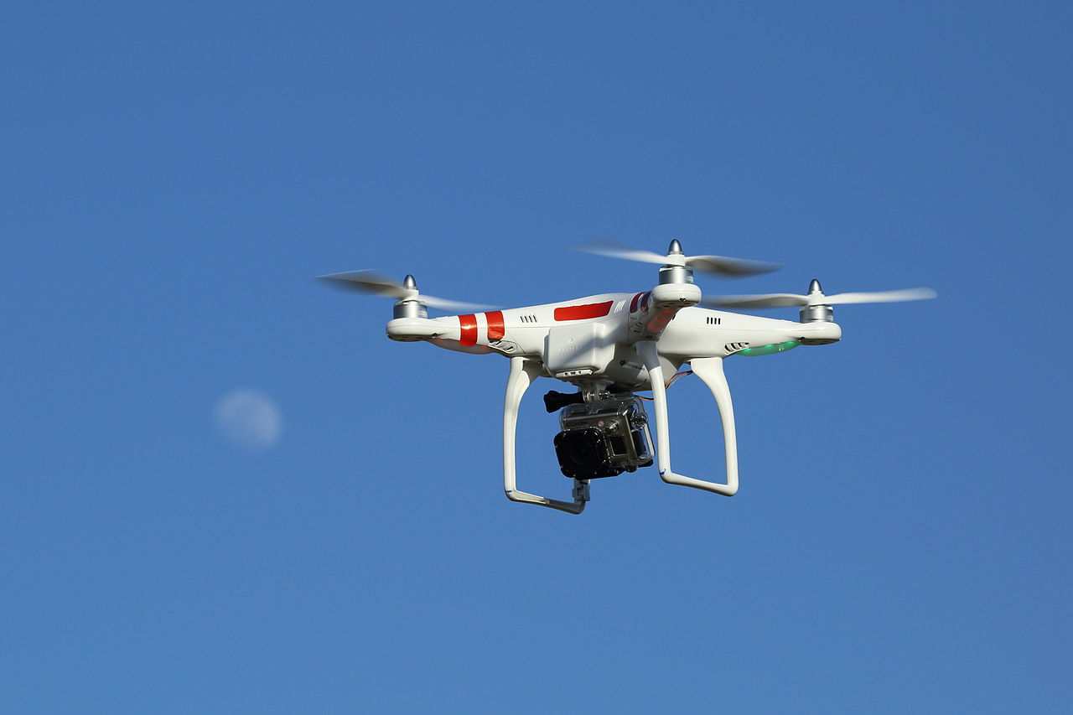
What is this?

Slide 5
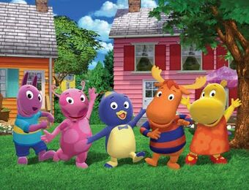
What television show is this?

Slide 6
Fill in the blanks
The Fairly ____________________ | ___Carly
__________Bob ___________Pants | Teen _________ Go!
________ Patrol | Daniel Tiger’s ___________

Slide 7
Do You know these shows?
Mean _________ | _______ School __________ | Pretty ______ _________
New _______________ | This is ____ | Station _____

Slide 8
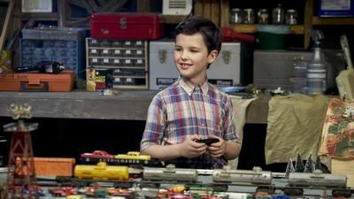
What Show is this?

Slide 9
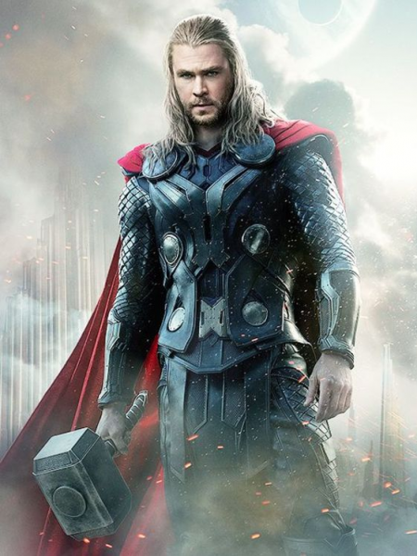
What Movie is this?

Slide 10
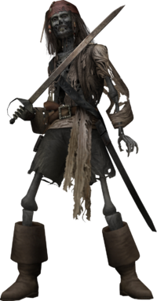
What movie is this?

Slide 11
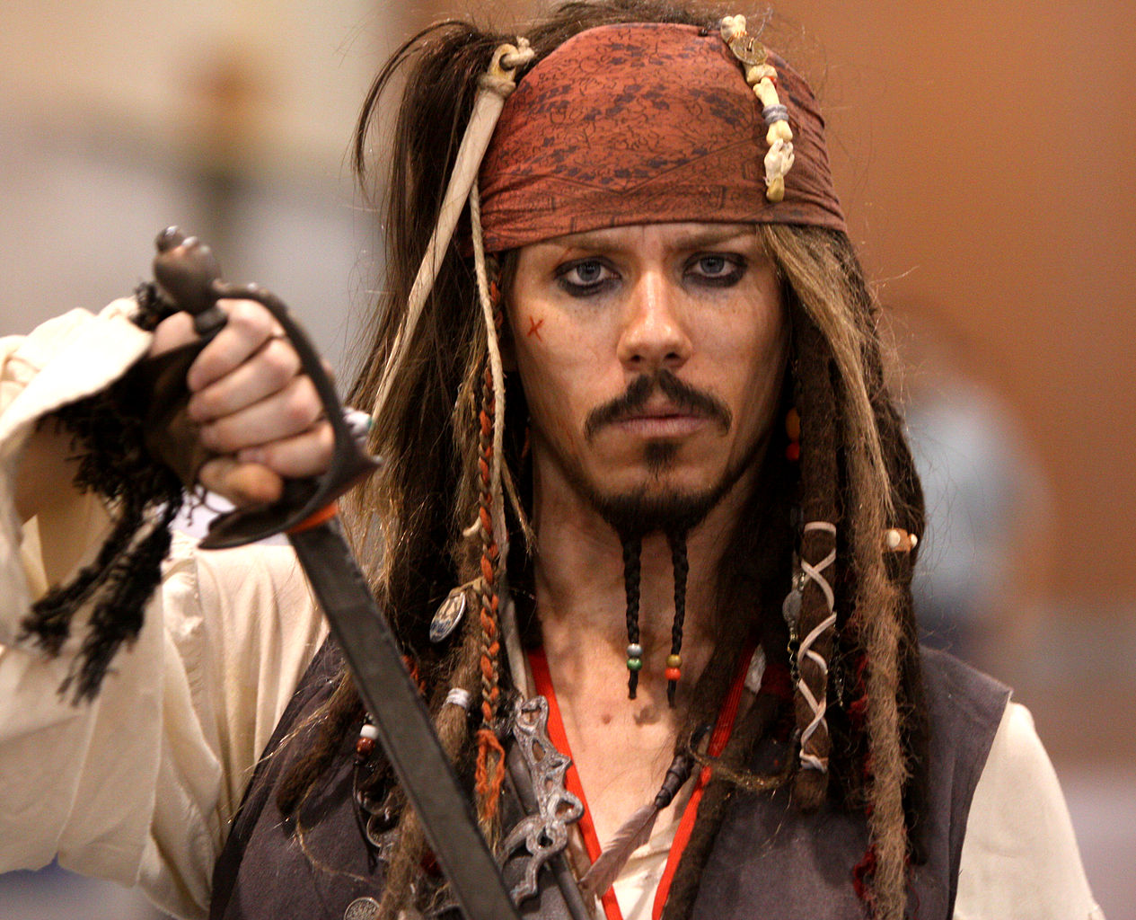
Who is this actor?

Slide 12
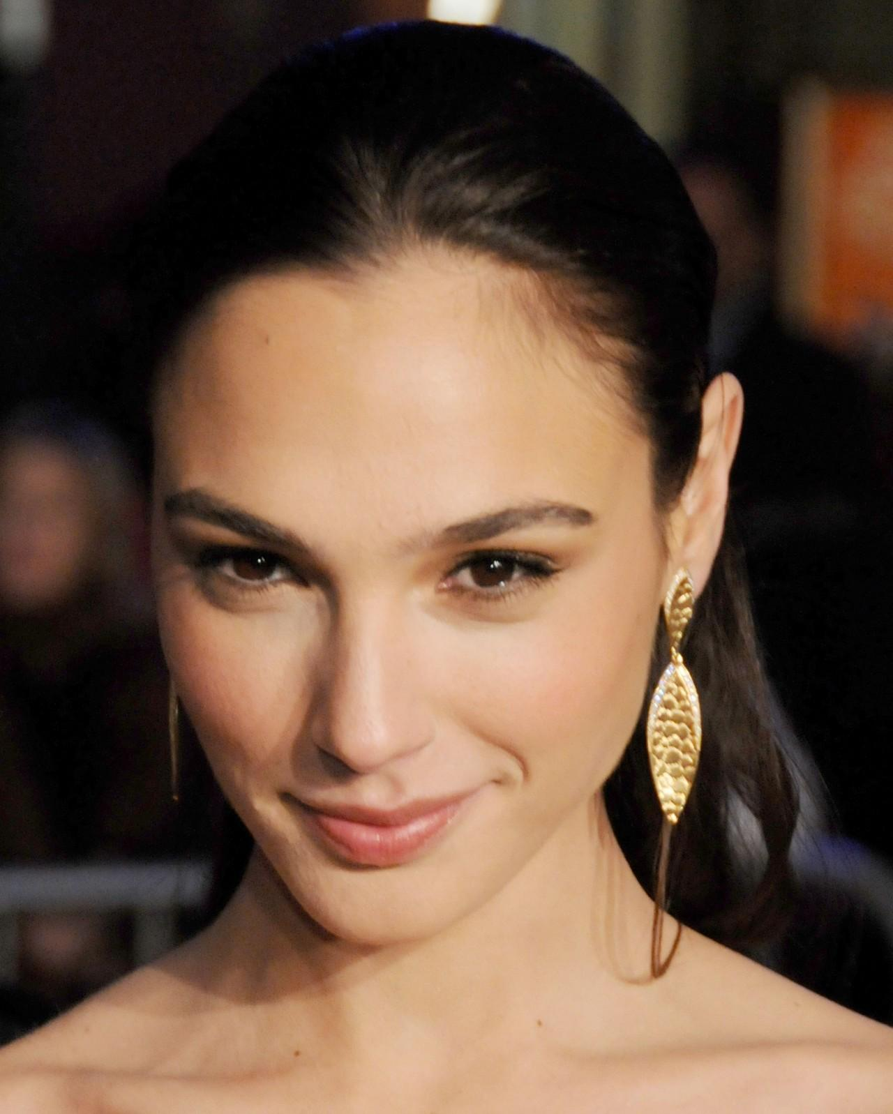
What movie is she in?

Slide 13
What show is this the music for?
Out Here

Slide 14
Name that Movie!
Movie #1

Slide 15
Name that Movie!
Movie #2

Slide 16
Who said this?
Sound Clip

Slide 17
What Show is This?
Theme Song

Slide 18
What Show is This?
Theme Song

Slide 19
What Show is This?
Theme Song

Slide 20
What Show is This?
Theme Song

Slide 21
What Show is This?
Theme Song

