Slide 1
Instructions
Some slides have an audio recording. Click on the button on the lower right-hand corner of the slide to hear the audio recording.
Each slide has an activity. Complete each activity on each slide before moving on to the next slide. Complete activities in the order presented beginning with Slide two, then slide three, all the way to the final slide, slide eight.
Slide number two asks you to access FLORA. The web site address is given. You must complete each part of the FLORA activities before moving on in this order: (J’écoute, Je lis, J’écris, Je chante, Je fais des activités)
Slide number six will ask you to read a text, ‘De nouveaux souliers’ twice. It is found in the Home Learning package. Read to a family member or aloud to yourself.
Please complete all written work for those activities that require written responses on separate sheets of looseleaf. Put the date and your name on each looseleaf sheet. Pass in all written work when classes resume.

Slide 2
Rechauffement: FLORA et Révision de vocabulaire
Warm up: FLORA and vocabulary review
Approximately 40 minutes
FLORA.nbed.nb.ca : Level 4: Module 2: J’écoute et je parle, Je lis, J’écris, Je chante, Je fais des activités
In the Home Learning package, you will find a handout with images for our unit “Les vêtements” Look over the list. Read aloud each article of clothing that we have seen thus far during this unit or that you hear in the song ‘Les vêtements “ by Alain le Lait.

Slide 3
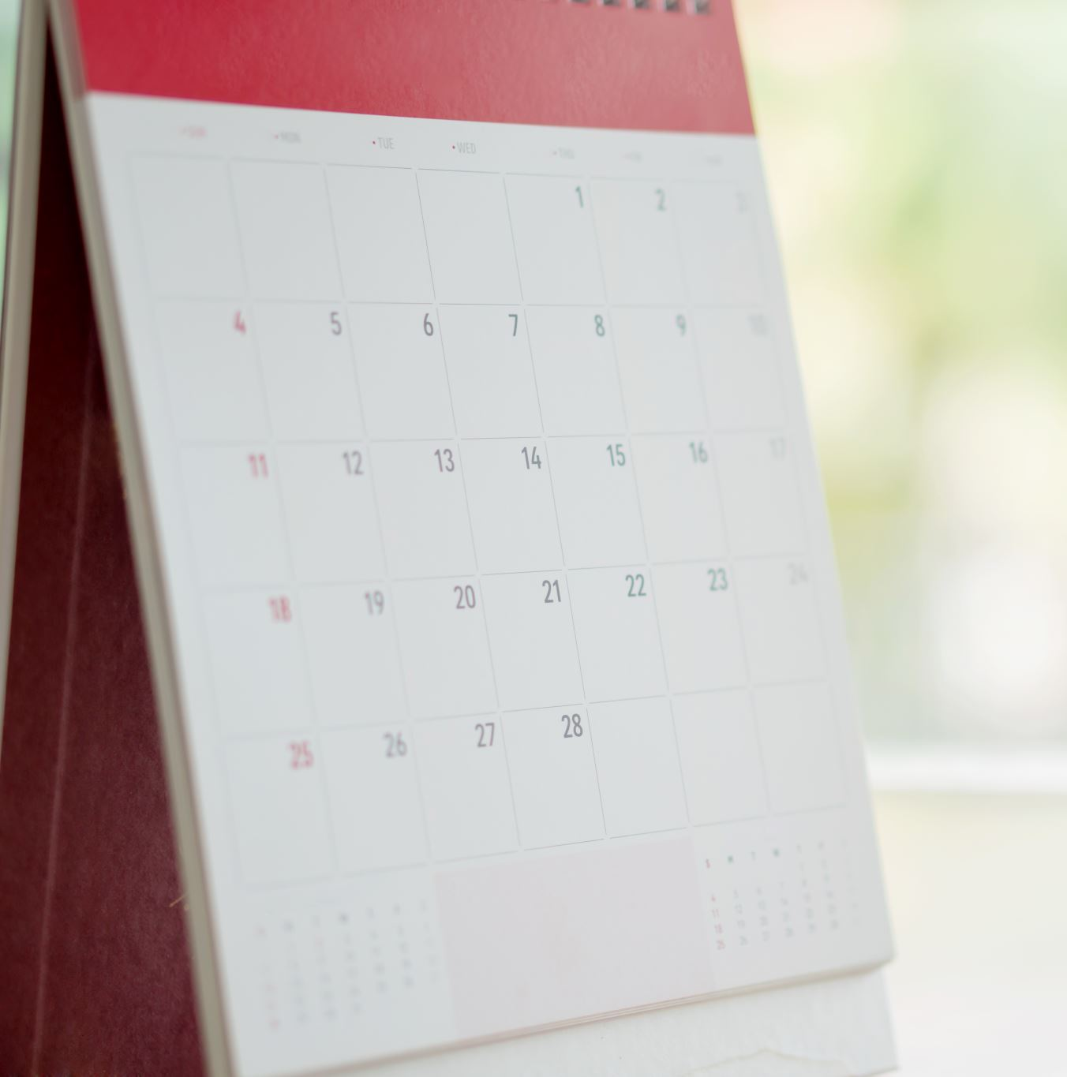

Message du jour
5 minutes
Bonjour tout le monde! C’est mardi le 18 Janvier 2022. Il fait 0 degrés Celsius ce matin. Il y a beaucoup de neige ici à max Aitken! Quelle belle journée de jouer dans la neige! À demain!
Activité: Listen to the recording. Re-read the message du jour aloud. Answer these questions in full sentence responses: Quelle est la temperature ce matin? Est-ce qu’il y a de la neige à max Aitken?
Click on the brown button on the bottom right-hand corner of this page for the audio recording.

Slide 4
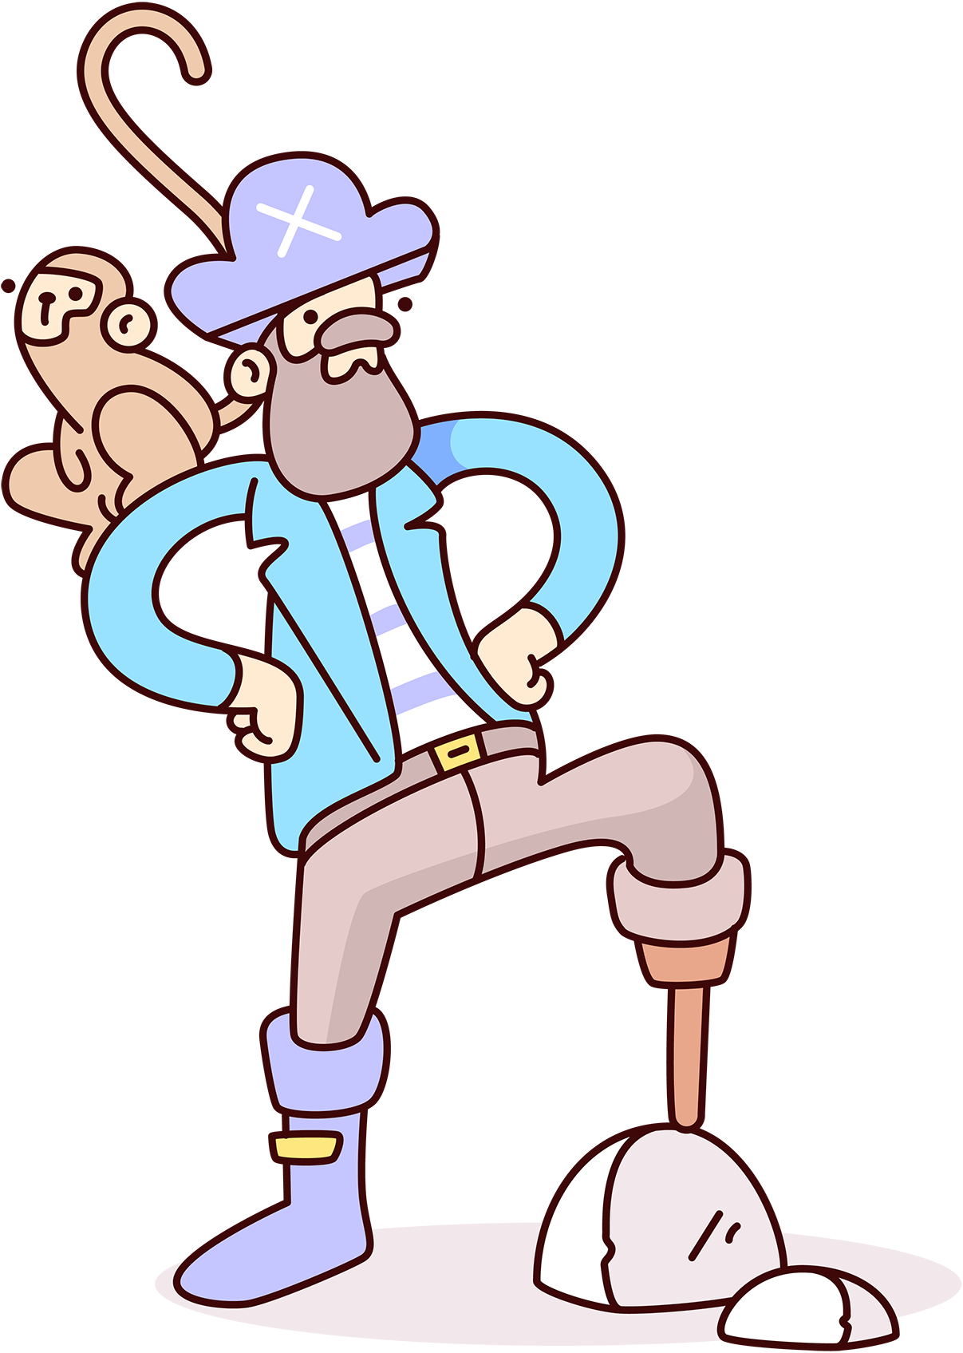
Les sons: “i” ‘o’ ‘a’ ‘é’ (5 minutes)
Pratiquez ces sons. Practice these sounds by reading the sentences aloud three times each.
Le son “i”
J’ai mis un chapeau sur la table.
Le son ‘o’
Pierre va au parc avec ses amis
Le son ‘a’
La classe est à la caféteria.
Le son ‘é’
J’aime manger la tarte aux bleuets.

Slide 5

Routines ( 2-3 minutes )
Répondez en phrases complètes:
Answer in full-sentence responses:
Comment ça va?
Comment t’appelles-tu?
Quel âge as-tu?
C’est quand ta fête?
Quel temps fait-il aujourd’hui?
Quelle est la date aujourd’hui?
Click on button on lower right-hand corner of this slide for the audio.

Slide 6

Lecture/ Reading: Lisez:
‘De nouveaux souliers’ deux fois. ( 5 minutes )
The selection is found in the home learning package.

Slide 7


Écoutez et chantez la chanson
Listen to and sing along to the song:
‘Les vêtements Alain le Lait”
2 minutes approximately
Search on Youtube :
Les vêtements Alain le lait

Slide 8
Ecriture/Writing: Write a sentence for each word below on a separate sheet of paper. See the example. (10 minutes)
Example: ceinture. J’ai acheté une nouvelle ceinture.
gant:
robe:
jupe:

